Slide 1
OS 2 – Project 2
Word Statistic (Files analyser)

Slide 2
Project Description
Project 2: Word Statistics:
Write a program that reads all text files form a specific directory and return word statistics (number of words
per file/directory, longest word, shortest word, number of “is”, “are” and “you”).
- The program should have a simple GUI
- The input of the program is a directory
o It should then search for all text files that reside in that directory
o There should be an option to check for text files in subdirectories
- While the program is processing text files, it should display them (file names) and the up-to-date
statistics. (Statistics should be updated in run time)

Slide 3
Project Members Role
ايمان ايهاب ابراهيم محمد 20210201
بثينه عصام محمد اسماعيل 20210218
تريڤينا رضا امين جرجس20210236
آيه محمد علي عبدالوهاب 20210210
بسام عماد حمدى عبدالكريم 20210222
باسم ياسر رجب عمر 20210217
جميل محمد جميل حسن 20210252
- Eman worked initializing the GUI components
- Buthaina worked on processDirectory() function.
-Terevena worked on listFilePaths() function.
-Aya worked on solving the problem of the program crashing when using a new directory while an old one is chosen.
- Gamil worked on creating counting/getting length functions.
- Bassam worked on creating main thread, file process thread and making an explanation video.
- Bassem Yasser worked on making the program real-time.

Slide 4
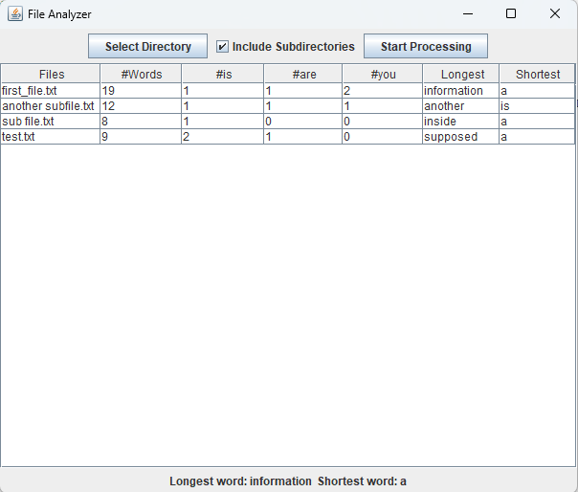
File analyser (Word statistic) Application
Lists out all files (Includes subdirs if needed).
Analyses each file in the chosen directory.
Gets the longest, shortest words among all files.
Output is in real-time.

Slide 5
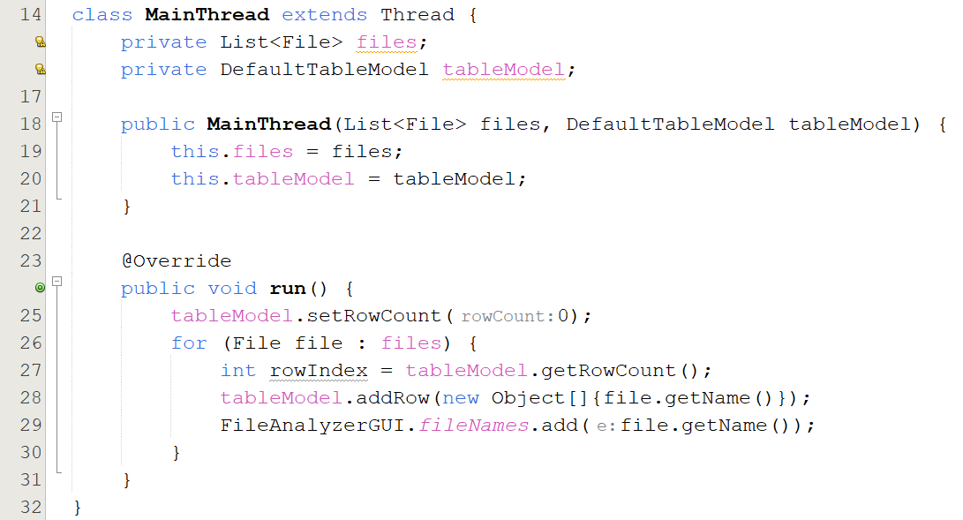
MainThread Thread
Extends Thread for concurrent processing
run(): Sets up the table model with file names

Slide 6
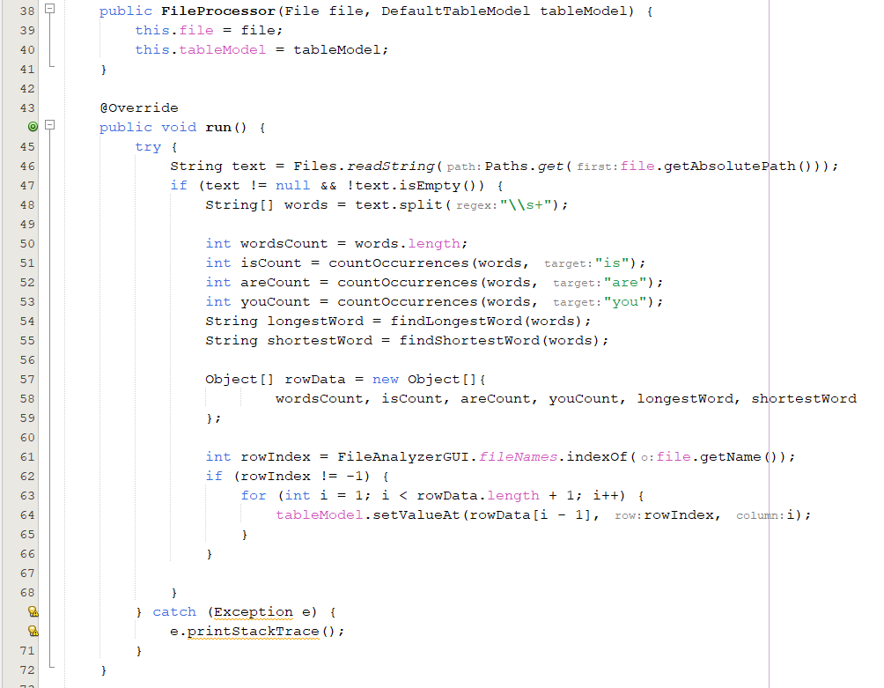
FileProcessor Thread
Extends Thread for processing individual files
run() : Processes files, counts words, finds longest/shortest words, then addes it to the table rows

Slide 7
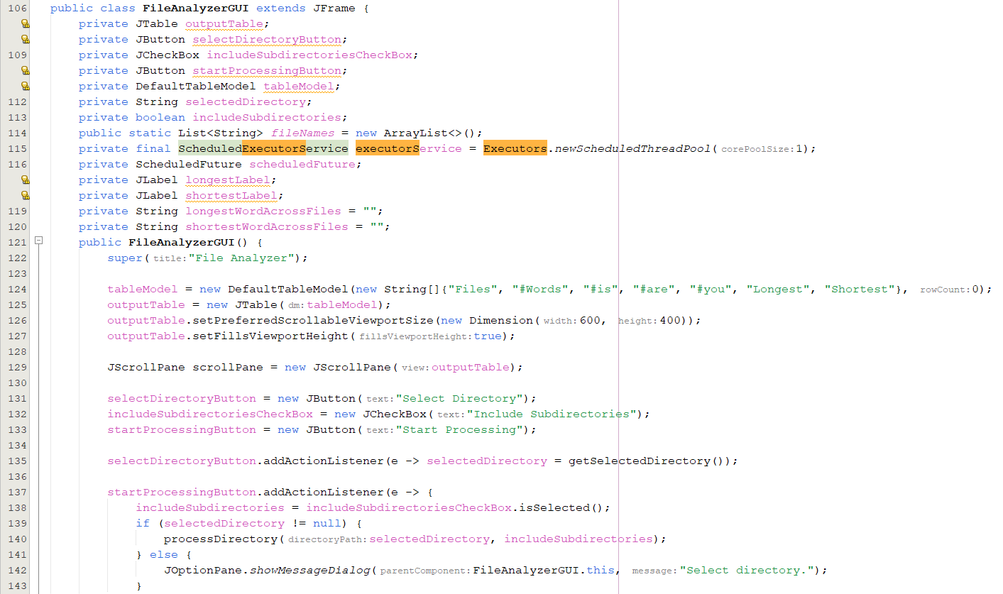
File Analyser GUI
This is a snippet from the main GUI class for the application.
Sets up buttons, checkbox, Jtable, Selected directory Path, etc…
Once startProcessing button is pressed, processDirectory() occurs.

Slide 8
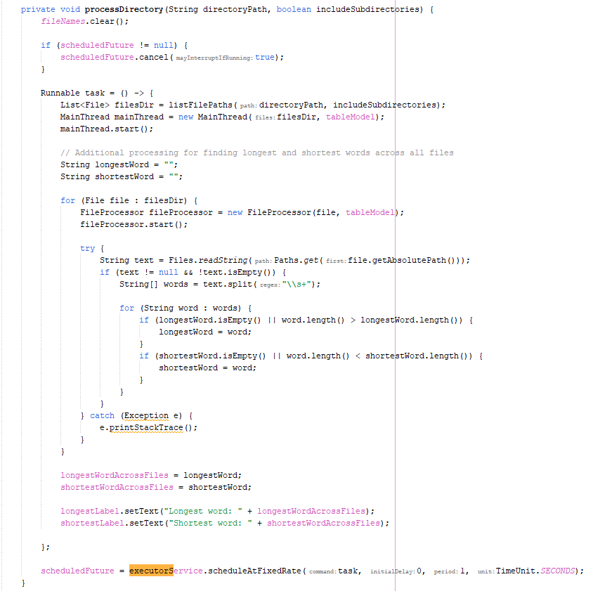
processDirectory()
This function takes the directoryPath as param, and a Boolean value includeSubdirs.
Makes sure the fileNames list is clear.
Cancels the previous scheduledFuture to prevent it from running two directories on the same time (In case user chooses another directory then it will clear the previous directory)
Creates a runnable that runs the MainThread along a FileProcessor thread for each file.
Calculates the longest and shortest among all files and adds them to the GUI labels.-
Runs an executorService to repeat the runnable process every 1 second (To capture updates in real-time).

Slide 9
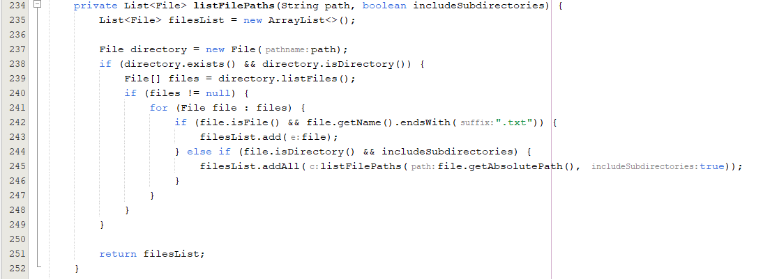
listFilePath()
Takes the directory path and if it includes subdirectories as params.
Lists out all txt files into that directory.
Returns the files paths as a list of files.

Slide 10


